Slide 1



International University - School of Computer Science and Engineering
22/7/2025
Thesis Defense:
Implementing a Test Generation Service For Flutter Framework
by: Đào Minh Huy - ITCSIU21132
Supervisor: Dr. Trần Thanh Tùng
Notes:
good morning everyone, thank you for being here today. I am excited to present to you my thesis project, which focuses on the development of a web data extraction system. This innovative tool is designed to simplify the process of web data extraction and subsequent data analysis, making it accessible to users without programming expertise

Slide 2


Outline
01
Introduction
02
Methodology
03
Demo
04
Conclusion
Notes:
so here's my outline
introduction: motivation, problem statement and project objectives
methodology: quick overview of the pipeline, components: fetch, extract, analyze, multi-level pipeline. we'll talk about the functionalities and the core logic of each component, however, i don't think there will be enough time for me to discuss very thoroughly about my algorithm and implementation, please feel free to ask me there
third: results and demo
finally, the implications and conclusion

Slide 3

01.
Introduction:
motivation, problem statement & objectives

Slide 4

What is Flutter?
Flutter is an open source, cross-platform framework.
Can be compiled into multi-platform applications from a single codebase
01.
Notes:
B

Slide 5


Problem statement
01.
Testing is essential
Tedious and time-comsuming
Notes:
where else is better to get data than from the web
that's when data extraction becomes important
being able to extract data is an advantage.
data is incredibly valuable.
organization: gain insights about customer's, trends, competitors,...
collect data to make informed decisions
competitors, customer's perferences to sell them your product, learn the market trend
- educator: information about student's progress, their opinions -> tailor your instruction and guidance in class.
data is valuable, helps gain insights

Slide 6

01.
Objective
Provide an intuitive interface for end-to-end process of analyzing and creating tests for a Flutter project
Support a wide range of test types
Build a scalable system that can support multiple frameworks
Notes:
so how are we going to solve that problem?

Slide 7


02.
Methodology

Slide 8
02.
Approach Explanation
Notes:
t

Slide 9



Direct Approach
02.
Notes:
t

Slide 10

TestSigma Approach
02.
Notes:
t

Slide 11




TestGenie Approach
02.
Avoid source code bias
Notes:
t

Slide 12
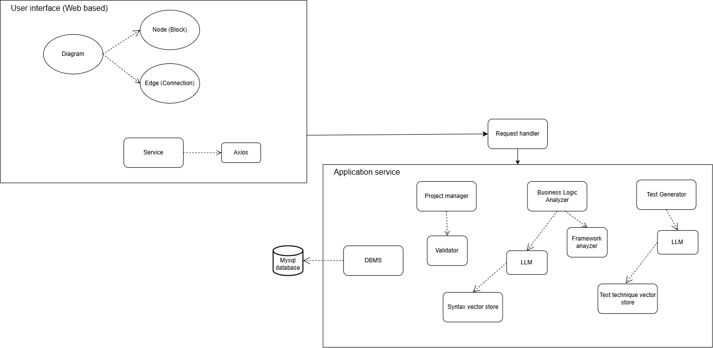
02.
System Design
Notes:
t

Slide 13
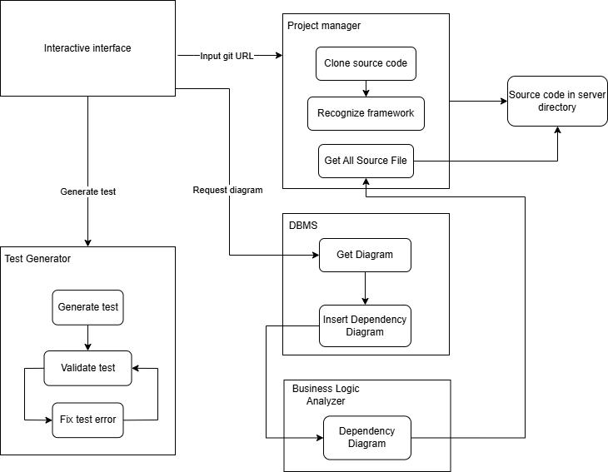
02.
Overall pipeline
Notes:
t

Slide 14

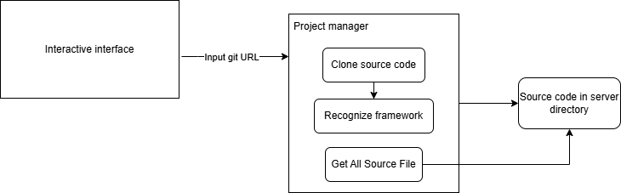
Project manager
module
2.1

Slide 15
2.2.
BLA Module
SOURCE CODE EXTRACTION

Slide 16
homepage.dart
main.dart
import 'package:flutter/material.dart';
class MyHomePage extends StatefulWidget {
MyHomePage({super.key, required this.title});
final String title;
@override
State<MyHomePage> createState() => _MyHomePageState();
}
class _MyHomePageState extends State<MyHomePage> {
int _counter = 0;
_incrementCounter() {
setState(() {
_counter++;
});
}
@override
Widget build(BuildContext context) {
return Scaffold(
appBar: AppBar(
backgroundColor: Theme.of(context).colorScheme.inversePrimary,
title: Text(widget.title),
),
body: Center(
child: Column(
const Text(
...........
import ‘package: sample/widgets/app.dart’
import 'package:flutter/material.dart';
void main() {
runApp(const MyApp());
}
app.dart
import 'package:flutter/material.dart';
import 'package:sample/widgets/screens/Homepage/homepage.dart';
class MyApp extends StatelessWidget {
const MyApp({super.key});
@override
Widget build(BuildContext context) {
return MaterialApp(
title: 'Flutter Demo',
theme: ThemeData(
colorScheme: ColorScheme.fromSeed(seedColor: Colors.deepPurple),
useMaterial3: true,
),
home: MyHomePage(title: 'Flutter Demo Home Page'),
);
}
}
Notes:
Step: 1
user defines info to extract. assume that user input is correct,
before:
-associate content with soup tag, search path from tag to root
go to next line to explain lca

Slide 17
app.dart
ImportAnalyzer
import 'package:flutter/material.dart';
import 'package:sample/widgets/screens/Homepage/homepage.dart';
main.dart
File
main.dart
File
app.dart
File
homepage.dart
import ‘package: sample/widgets/app.dart’
import 'package:flutter/material.dart';
homepage.dart
import 'package:flutter/material.dart';
Notes:
Step: 1
user defines info to extract. assume that user input is correct,
before:
-associate content with soup tag, search path from tag to root
go to next line to explain lca

Slide 18
main.dart
ContainAnalyzer
void main() {
runApp(const MyApp());
}
File
main.dart
File
app.dart
File
homepage.dart
Function
void main()
Notes:
Step: 1
user defines info to extract. assume that user input is correct,
before:
-associate content with soup tag, search path from tag to root
go to next line to explain lca

Slide 19
app.dart
ContainAnalyzer
class MyApp extends StatelessWidget {
const MyApp({super.key});
@override
Widget build(BuildContext context) {
return MaterialApp(
title: 'Flutter Demo',
theme: ThemeData(
colorScheme: ColorScheme.fromSeed(seedColor: Colors.deepPurple),
useMaterial3: true,
),
home: MyHomePage(title: 'Flutter Demo Home Page'),
);
}
}
File
main.dart
File
app.dart
File
homepage.dart
Function
void main()
Class
MyApp extends StatelessWidget
ClassFunction
Widget build(BuildContext context)
Notes:
Step: 1
user defines info to extract. assume that user input is correct,
before:
-associate content with soup tag, search path from tag to root
go to next line to explain lca

Slide 20
homepage.dart
ContainAnalyzer
class MyHomePage extends StatefulWidget {
MyHomePage({super.key, required this.title});
final String title;
@override
State<MyHomePage> createState() => _MyHomePageState();
}
File
main.dart
File
app.dart
File
homepage.dart
Class
MyHomePage extends StatefulWidget
Function
void main()
Class
MyApp extends StatelessWidget
ClassFunction
Widget build(BuildContext context)
ClassAttribute
String title
ClassFunction
State<MyHomePage> createState()
Notes:
Step: 1
user defines info to extract. assume that user input is correct,
before:
-associate content with soup tag, search path from tag to root
go to next line to explain lca

Slide 21
homepage.dart
ContainAnalyzer
class _MyHomePageState extends State<MyHomePage> {
int _counter = 0;
_incrementCounter() {
setState(() {
_counter++;
});
}
File
main.dart
File
app.dart
File
homepage.dart
Function
void main()
Class
MyApp extends StatelessWidget
Class
_MyHomePageState extends State<MyHomePage>
Class
MyHomePage extends StatefulWidget
ClassFunction
Widget build(BuildContext context)
ClassFunction
State<MyHomePage> createState()
ClassAttribute
String title
ClassFunction
_incrementCounter()
ClassAttribute
int _counter
Notes:
Step: 1
user defines info to extract. assume that user input is correct,
before:
-associate content with soup tag, search path from tag to root
go to next line to explain lca

Slide 22
homepage.dart
ContainAnalyzer
@override
Widget build(BuildContext context) {
return Scaffold(
appBar: AppBar(
backgroundColor: Theme.of(context).colorScheme.inversePrimary,
title: Text(widget.title),
),
File
main.dart
File
app.dart
File
homepage.dart
Function
void main()
Class
MyApp extends StatelessWidget
Class
MyHomePage extends StatefulWidget
Class
_MyHomePageState extends State<MyHomePage>
ClassFunction
Widget build(BuildContext context)
ClassFunction
Widget build(BuildContext context)
ClassAttribute
int _counter
ClassFunction
State<MyHomePage> createState()
ClassAttribute
String title
ClassFunction
_incrementCounter()
Notes:
Step: 1
user defines info to extract. assume that user input is correct,
before:
-associate content with soup tag, search path from tag to root
go to next line to explain lca

Slide 23
main.dart
CallAnalyzer
void main() {
runApp(const MyApp());
}
File
main.dart
File
app.dart
File
homepage.dart
Function
void main()
Class
MyApp extends StatelessWidget
Class
MyHomePage extends StatefulWidget
Class
_MyHomePageState extends State<MyHomePage>
ClassFunction
Widget build(BuildContext context)
ClassFunction
Widget build(BuildContext context)
ClassAttribute
int _counter
ClassFunction
State<MyHomePage> createState()
ClassAttribute
String title
ClassFunction
_incrementCounter()
Notes:
Step: 1
user defines info to extract. assume that user input is correct,
before:
-associate content with soup tag, search path from tag to root
go to next line to explain lca

Slide 24
app.dart
CallAnalyzer
return MaterialApp(
title: 'Flutter Demo',
theme: ThemeData(
colorScheme: ColorScheme.fromSeed(seedColor: Colors.deepPurple),
useMaterial3: true,
),
home: MyHomePage(title: 'Flutter Demo Home Page'),
);
File
main.dart
File
app.dart
File
homepage.dart
Function
void main()
Class
MyApp extends StatelessWidget
Class
MyHomePage extends StatefulWidget
Class
_MyHomePageState extends State<MyHomePage>
ClassFunction
Widget build(BuildContext context)
ClassFunction
Widget build(BuildContext context)
ClassAttribute
int _counter
ClassFunction
State<MyHomePage> createState()
ClassAttribute
String title
ClassFunction
_incrementCounter()
Notes:
Step: 1
user defines info to extract. assume that user input is correct,
before:
-associate content with soup tag, search path from tag to root
go to next line to explain lca

Slide 25
homepage.dart
CallAnalyzer
class MyHomePage extends StatefulWidget {
MyHomePage({super.key, required this.title});
final String title;
@override
State<MyHomePage> createState() => _MyHomePageState();
}
File
main.dart
File
app.dart
File
homepage.dart
Function
void main()
Class
MyApp extends StatelessWidget
ClassFunction
Widget build(BuildContext context)
Class
MyHomePage extends StatefulWidget
Class
_MyHomePageState extends State<MyHomePage>
ClassAttribute
String title
ClassFunction
State<MyHomePage> createState()
ClassAttribute
int _counter
ClassFunction
_incrementCounter()
ClassFunction
Widget build(BuildContext context)
Notes:
Step: 1
user defines info to extract. assume that user input is correct,
before:
-associate content with soup tag, search path from tag to root
go to next line to explain lca

Slide 26
homepage.dart
CallAnalyzer
class _MyHomePageState extends State<MyHomePage> {
int _counter = 0;
_incrementCounter() {
setState(() {
_counter++;
});
}
File
main.dart
File
app.dart
File
homepage.dart
Function
void main()
Class
MyApp extends StatelessWidget
ClassFunction
Widget build(BuildContext context)
Class
MyHomePage extends StatefulWidget
Class
_MyHomePageState extends State<MyHomePage>
ClassAttribute
String title
ClassFunction
State<MyHomePage> createState()
ClassAttribute
int _counter
ClassFunction
Widget build(BuildContext context)
ClassFunction
_incrementCounter()
Notes:
Step: 1
user defines info to extract. assume that user input is correct,
before:
-associate content with soup tag, search path from tag to root
go to next line to explain lca

Slide 27
homepage.dart
CallAnalyzer
@override
Widget build(BuildContext context) {
return Scaffold(
appBar: AppBar(
backgroundColor: Theme.of(context).colorScheme.inversePrimary,
title: Text(widget.title),
),
File
main.dart
File
app.dart
File
homepage.dart
Function
void main()
Class
MyApp extends StatelessWidget
ClassFunction
Widget build(BuildContext context)
Class
MyHomePage extends StatefulWidget
Class
_MyHomePageState extends State<MyHomePage>
ClassAttribute
String title
ClassAttribute
int _counter
ClassFunction
State<MyHomePage> createState()
ClassFunction
Widget build(BuildContext context)
ClassFunction
_incrementCounter()
Notes:
Step: 1
user defines info to extract. assume that user input is correct,
before:
-associate content with soup tag, search path from tag to root
go to next line to explain lca

Slide 28
homepage.dart
CallAnalyzer
floatingActionButton: FloatingActionButton(
onPressed: _incrementCounter,
tooltip: 'Increment',
child: const Icon(Icons.add),
), // This trailing comma makes auto-formatting nicer for build methods.
);
File
main.dart
File
app.dart
File
homepage.dart
Function
void main()
Class
MyApp extends StatelessWidget
ClassFunction
Widget build(BuildContext context)
Class
MyHomePage extends StatefulWidget
Class
_MyHomePageState extends State<MyHomePage>
ClassAttribute
String title
ClassAttribute
int _counter
ClassFunction
State<MyHomePage> createState()
ClassFunction
Widget build(BuildContext context)
ClassFunction
_incrementCounter()
Notes:
Step: 1
user defines info to extract. assume that user input is correct,
before:
-associate content with soup tag, search path from tag to root
go to next line to explain lca

Slide 29
Prediction Structure
1. Brief explanation of what the code does
2. Testability assessment
3. Testing scenarios (test plan)
### Brief Explanation of What the Code Does
The function calculates the .......
### Testability Assessment
The code is generally testable due to ........
### TESTING SCENARIOS
1. **.........**: ......
- Input:
- Expected:
2. **......**: ......
- Input:
- Expected:

Slide 30
2.3
Use AI to generate test files
Input: package_name, code_location, function_name_and_argument, prediction
Use Project Manager to validate test (loop)
Test Generator
Module

Slide 31

DEMO
04.

Slide 32
Conclusion
The project has successfully:
Addresses fundamental challenges in software testing through an innovative block-based analysis approach
Supported a variety of test types
Contributions to both academic understanding and practical application in software engineering
04.

Slide 33
Implications and Future Work
Improve automated test generation process efficiency
Improvements: Expand numbers of supporting frameworks, optimize algorithms, enhance system’s handling of complex state management
Human-in-the-loop design philosophy demonstrates how AI and human expertise can be combined
04.

